Slide 1
Agile Development
Topic 3:
Modelling
Notes:
NCC Education - Title Master

Slide 2
Topic 3 Coverage
This topic will cover:
  Meanings and examples of modelling;
  Modelling perspectives;
  Modelling within the lifecycle;
  Modelling tips.
Notes:
Modelling is key to the design process and Agile Development focuses on building communication throughout the design and development process to ensure that the product that is being developed meets the requirements.
In the Agile Development process the need for modelling is increased compared to other development methods due to the nature of the rapid development that takes place. Without modelling a project could fail if the development that has already taken place fails to meet the requirements, this could of course delay delivery or impact on costs.

Slide 3





DSDM - 5 Key Techniques
  MoSCoW Prioritisation
  Modelling
  Facilitated Workshops
  Iterative Development
  Timeboxing
Source: Image from dsdm.org © 2016
Notes:
DSDM uses;
MoSCoW to set the priorities for projects
Modelling to demonstrate elements using things like storyboard; illustrations; blue prints and so on
Facilitated workshops to build communication and showcase designs/ working parts
Iterative development, breaking the project into parts and developing them rapidly
Timeboxing to set clear blocks of time for set objectives to be met and delivered

Slide 4
Exercise 1
A model is often a diagram. So, what diagrams do you know/use in a development project?
Notes:
Prepare flip charts with 6 cells. Each group puts six different diagrams onto this, with a name.
Examples include:
UML (Unified Modelling Language)
DFD (Data Flow Diagrams)
Flowcharts
ERD (Entity Relationship Diagrams)
Use Case Diagrams
Class diagrams etc
Objective to see diagrams in common;
Examples:
Logic
Flow
Links/Relationships
Start/end points
Steps
Order
Descriptions
DSDM ATERN
Modelling
ATERN S2 modelling

Slide 5
What is a Model? - 1
  A model is:
    A description or analogy (to help visualise something that cannot be directly observed);
    A small but precise replica of an item or product;
    A pattern or figure of an item or product to be created.
Notes:
A model is used to help visualise something that is not yet created. It will show, in varied levels of detail, what something will look like.

Slide 6
What is a Model? - 2
  Many industries use models (and prototypes) to establish requirements, confirm expectations and test the achievability of objectives. Examples of models include: storyboards; diagrams; scale models (prototypes); and working software (prototypes).
Notes:
A model will be used across industries as a means to ensure that requirements are detailed effectively; expectations are outlined or to test possibilities.
Storyboards and diagrams helps to show the stages and flow of a project. Prototypes are commonly used to highlight functionality.

Slide 7
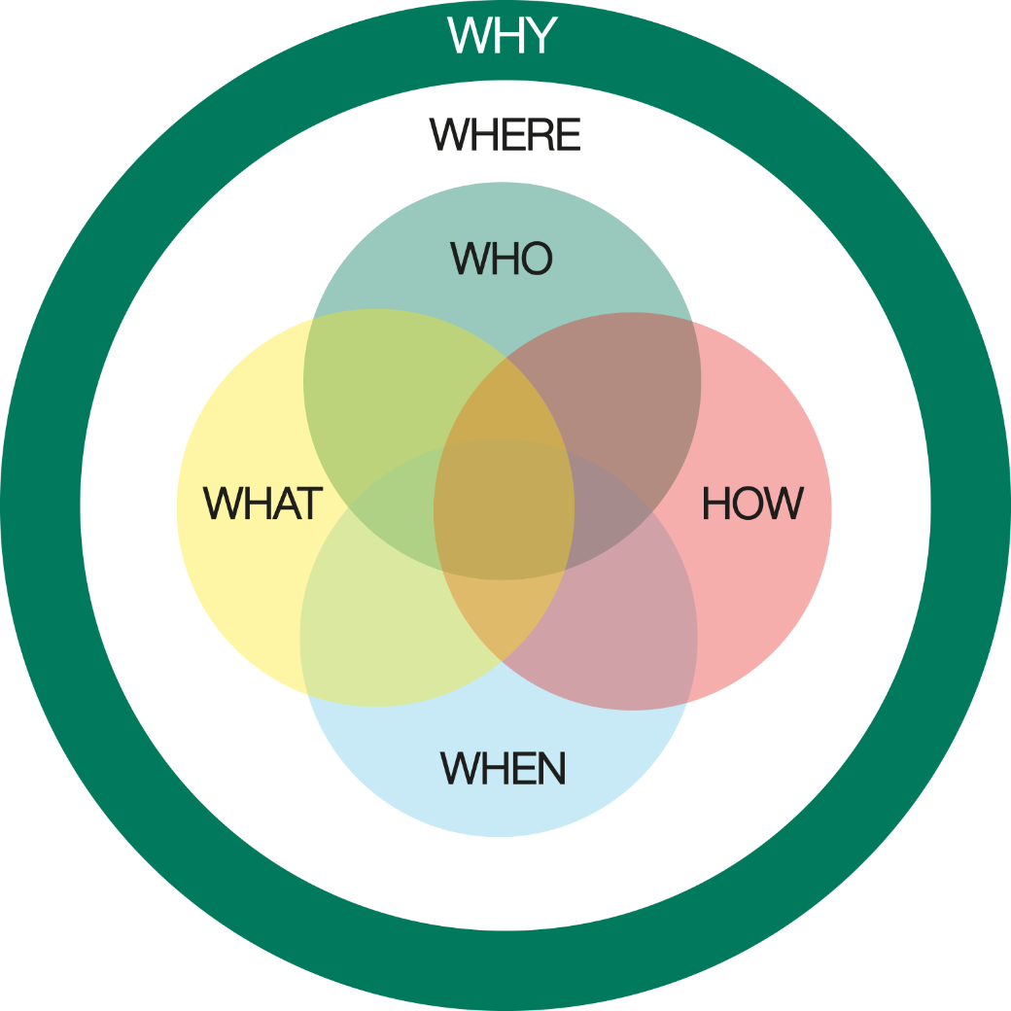
Modelling Perspectives
WHAT – The information
HOW – The functions, features and processes
WHERE – The locations at which the business operates
WHO – The people: customers, users, stakeholders
WHEN –The events of importance (times and scheduling)
WHY – The business objectives and strategy
Source: Image from dsdm.org © 2016
Notes:
There are 6 perspectives to consider when modelling;
WHAT - The information within the solution area, data, relationships and business rules.
HOW - The functions, features and processes within the solution area
WHERE - The locations at which the business operates, in relation to the solution area
WHO - The people: customers, users, stakeholders
WHEN - The events of importance to the business (times and scheduling)
WHY - The business objectives and strategy, as related to the project

Slide 8

Modelling – User Perspective
Technology may have its own:
WHEN
Business Events
time and
scheduling
HOW:
Processes, Inputs, Outputs
WHY
Rationale
WHAT:
Data and
Relationships
WHEN:
System Events
WHAT?
Data
WHAT
Business
Procedures
WHO
People
and Tasks
WHERE
Locations and Links
Source: Image from pixabay.com © 2016
Notes:
When teams work together to model a project they will build clear reasoning and justification that ensures all 6 perspectives are covered and will work together to meet the requirements of the business.
Individuals from many departments may be involved, including; Finance, Facilities, Technical/IT, Human Resources, Operations etc.

Slide 9
Exercise 2
In small groups, one person describes a journey using words only. The others (independently) try to draw the route. How close is the picture to the description?
Notes:
Paper and pens should be made available for this task.
DSDM ATERN
Modelling
ATERN S2 modelling

Slide 10
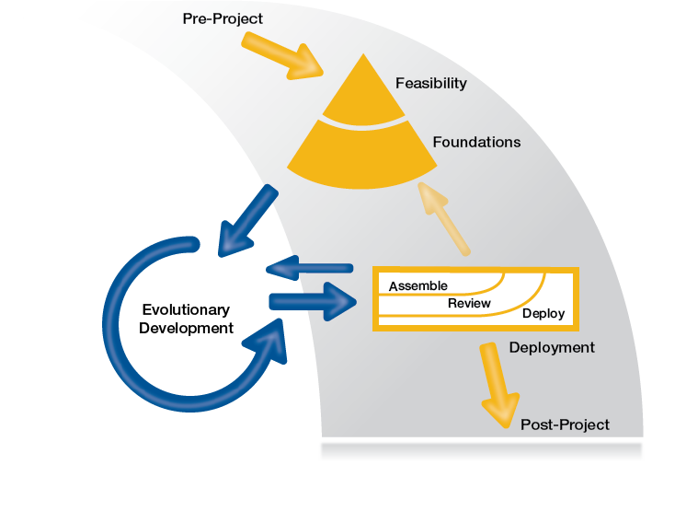
Modelling within the Lifecycle
Feasibility
Scope and Enterprise Model
Business Sponsor
Wider Stakeholder Group
Foundations
High Level System Models
Business Sponsor
Business Visionary
Technical Co-ordinator
Exploration/Design
Detailed System Models
Solution Development Team
Deployment
Functioning, Tested,
Documented System
End Users
Operations
Engineering/Development
Technology and Component Models
Solution Development Team
Source: Image from dsdm.org © 2016
Notes:
Modelling occurs at all stages of the lifecycle process, with key stakeholders playing their role at the required points. The wider team will all be involved at the feasibility stage as this is where the strategic planning takes place. This will include setting the timescales and budgets.
The foundation stage only requires those who need to focus the resources.
During the initial design and development phase only the development team will need to be involved formally, but they are likely to need to showcase models to the wider team during these stages.
Deployment will centre strongly around the user.

Slide 11



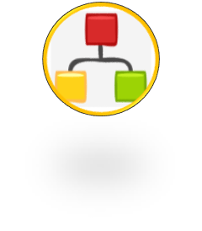
Some User-centred Techniques - 1
User Analysis
Usability Analysis
Task Modelling
Task Scenario Definition
(& Use Cases)
identify user population for the proposed system (job roles, skill levels)
determine characteristics of user interface (non-functional requirements)
identify business events (user tasks)
identify instances of task execution for a user
Source: Image from pixabay.com © 2016
dsdm.org@2016
Notes:
There are several ways to get the user involved. You can use;
User Analysis – to build a clear picture of who will be using the system
Usability Analysis – to define what features the system needs
Task Modelling – to identify functionality
Task Scenario Definition inc Use Cases – to clearly define what tasks the user needs to complete

Slide 12
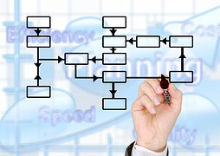


Some User-centred Techniques - 2
User Conceptual Modelling
(user object modelling)
GUI Design
User Interface Prototyping
provide a map of the system from the users’ perspective
user interface to support identified tasks
provide animated view of proposed system
Source: Image from pixabay.com © 2016
Notes:
Further user centred techniques include;
User conceptual modelling – providing a clear map/plan of the system for the users
GUI Design – planning the user interface to maximise efficiency of the system to complete tasks
User Interface Prototyping – provides and highly visual example of the system

Slide 13
The 8 Principles of DSDM
Focus on business need
Deliver on time
Collaborate
Never compromise quality
Build incrementally from foundations
Develop iteratively
Communicate continuously and clearly
Demonstrate control

Slide 14
Exercise 3
In small groups of no more than 4, prepare a short presentation to last no more than TWO (2) mins
to link modelling to the 8 principles of DSDM.

Slide 15
Modelling Tips
  Key points to consider are:
    It is easily understood by user and developer;
    It supports the process of incremental refinement;
    Models produced must enhance communication;
    It must fit easily within the Agile framework.
Notes:
Modelling is not a tick box exercise. It is paramount to ensure that the development meets the requirements.
Modelling must be:
Easily understood by the user to ensure they are able to sign off of each element of the project.
Support the process of incremental refinement, this means that they can view the model, make refinements/enhancements ready for the next phase in the development to commence.
Models produced must enhance communication with the user and ensure their needs are being met by the project. If they aren’t then this will be the opportunity to ensure it will.
Modelling can occur throughout the Agile Development process and involve set stakeholders at set times. Modelling at a stage where the right stakeholder won’t be able to feed in and make refinements would be inefficient use of modelling.

Slide 16
Summary of Modelling
  What is modelling?
    It is a visualisation process to build focus within a project.
  Modelling perspectives
    When, Why, What, Who, Where and How?
  Modelling within the lifecycle
    Used at all stages by differing stakeholders for varied reasons to ensure project objectives are met.
  Modelling tips
    Make it count! Modelling needs to be easy to understand and fit within all aspects of the life cycle. It will greatly enhance communication.

Slide 17
Topic 3 – Modelling
Any Questions?
Notes:
NCC Education - End Slide Master

